Slide 1
NoSQL Programming
Trainer : Pradnyaa S Dindorkar
Email: pradnya@sunbeaminfo.com

Slide 2
Introduction to NoSQL
MongoDB
Redis
Cassendra

Slide 3
What are we going to cover?
What is NoSQL and how is it different from RDBMS?
What is JSON?
Introduction to MongoDB
JSON vs BSON
MongoDB Fundamentals
Basic CRUD operations
Performance optimization
Data Modeling
Aggregation Pipeline
Introduction to Geospatial Queries

Slide 4
Todyas Topics
What is database?
Quick recap of sql,
limitation of sql,
intro of nosql ,
CAP theorem and BASE theorem
types of nosql
Advantages of NoSQL
Disadvantages of NoSQL
NoSQL Scenarios,
SQL vs NoSQL

Slide 5
What is Database ?
A database is an organized collection of data, generally stored and accessed electronically from a computer system
A database refers to a set of related data and the way it is organized
Database Management System
Software that allows users to interact with one or more databases and provides access to all of the data contained in the database
Types
RDBMS (SQL)
NoSQL

Slide 6
RDMBS
The idea of RDBMS was borne in 1970 by E. F. Codd
The language used to query RDBMS systems is SQL (Sequel Query Language )
RDBMS systems are well suited for structured data held in columns and rows, which can be queried using SQL
Supports: DML, DQL, DDL, DTL, DCL
The RDBMS systems are based on the concept of ACID transactions
Atomic: implies either all changes of a transaction are applied completely or not applied at all
Consistent: data is in a consistent state after the transaction is applied
Isolated: transactions that are applied to the same set of data are independent of each other
Durable: the changes are permanent in the system and will not be lost in case of any failures

Slide 7
Scaling
Scalability is the ability of a system to expand to meet your business needs
E.g. scaling a web app is to allow more people to use your application
Types
Vertical scaling
Add resources within the same logical unit to increase capacity
E.g. increase memory in the system or expanding storage by adding hard drives
Horizontal scaling
Add more nodes to a system
E.g. adding a new computer to a distributed software application
Based on principle of distributed computing
NoSQL databases are designed for Horizontal scaling
So they are reliable, fault tolerant, better performance (at lower cost)

Slide 8
NoSQL
Stands for Not Only SQL
NoSQL is a term used to refer to non-relational databases
The term NoSQL was coined by Carlo Strozzi in 1998 .
Does not use any declarative query language
No predefined schema no restriction over the schema
Unstructured and unpredictable data
Supports eventual consistency rather than ACID properties
Prioritizes high performance, high availability and scalability
In contrary to the ACID approach of traditional RDBMS systems, NoSQL solves the problem using an approach popularly called as BASE

Slide 9
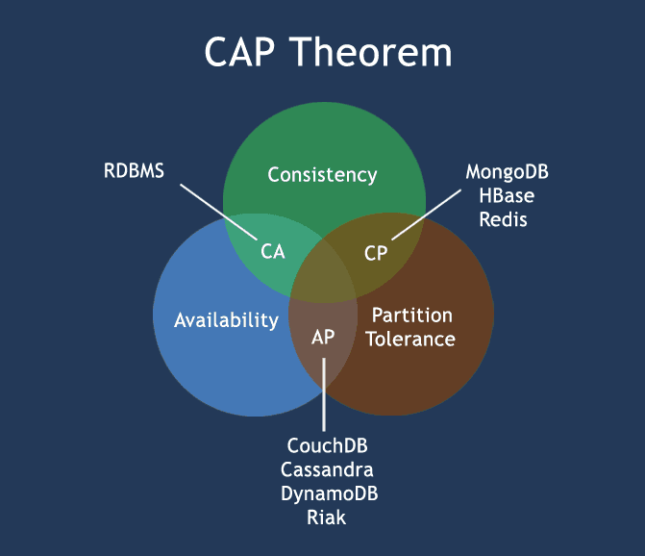
CAP Theorem
Also known as Brewer's theorem states that it is impossible for a distributed data store to simultaneously provide more than two out of the following three guarantees
Consistency
Data is consistent after operation
After an update operation, all clients see the same data
Availability
System is always on (i.e. service guarantee), no downtime
Partition Tolerance
System will continue to function even if it is partitioned into groups of servers that are not able to communicate with one another

Slide 10
BASE Theorm
Eric Brewer coined the BASE acronym
BASE means
Basically Available: means the system will be available in terms of the CAP theorem.
Soft state indicates that even if no input is provided to the system, the state will change over time. This is in accordance to eventual consistency.
Eventual consistency: means the system will attain consistency in the long run, provided no input is sent to the system during that time.

Slide 11
NoSQL Types
Following are the types of NoSQL database based on how it stores the data
Key Value
Document DB
Column Based DB
Graph DB

Slide 12
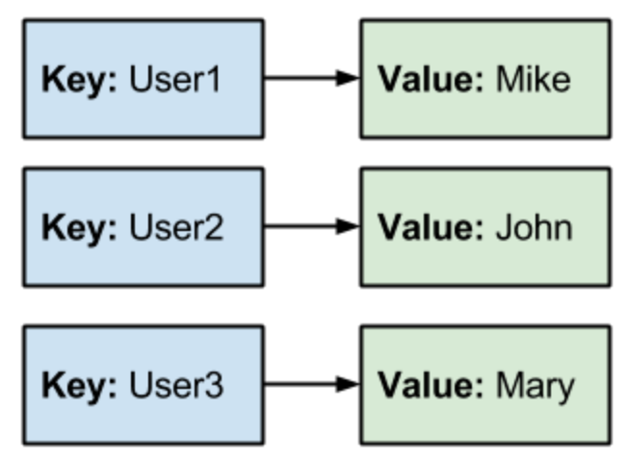
Key Value Database
Data is stored as keys and values
Provides super fast queries and ability to scale almost infinite data and performance level
No relationships and weak/no schema
E.g.
DynamoDB
Redis
Couchbase

Slide 13
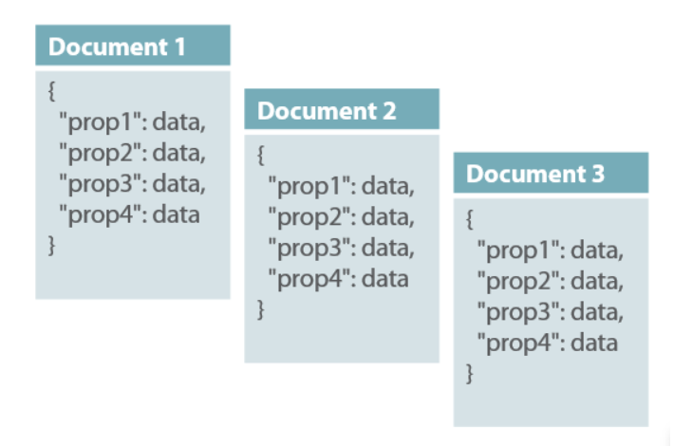
Document DB
Data is stored as Documents
Document: collection of key-value pairs with structure
Great performance when interacting with documents
E.g.
MongoDB
CouchDB
RethinkDB

Slide 14
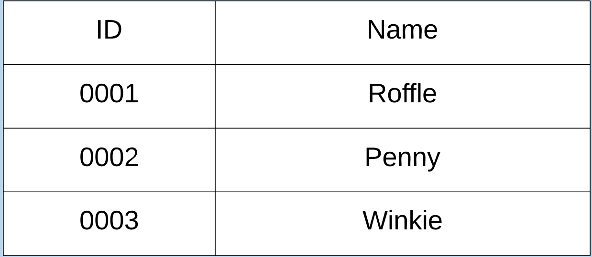
Column Based DB
Data is stored as columns rather than rows
Fast queries for datasets
Slower when looking at individual records
Great for warehousing and analytics
E.g.
Redshift
Cassandra
HBase
Vertica

Slide 15
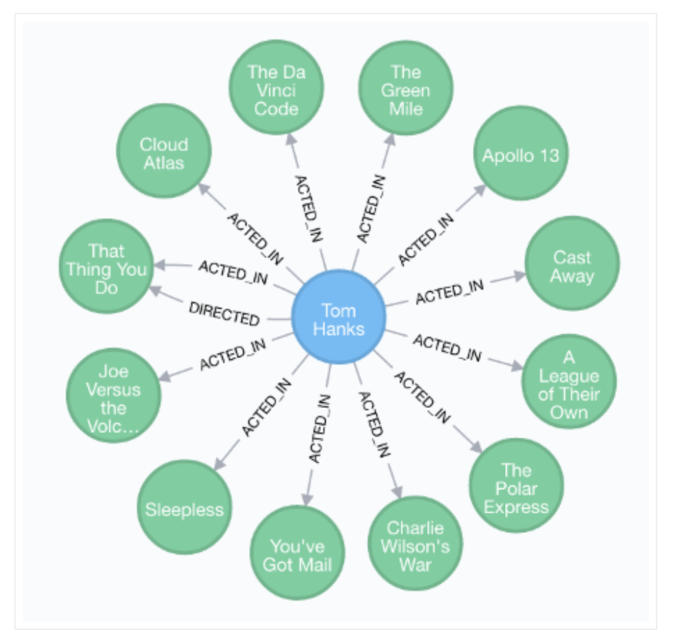
Graph DB
Designed for dynamic relationship
Stores data as nodes and relationships between those nodes
Ideal for human related data like social media
Often as custom query language
E.g.
Neo4J
Giraph
OrientDB

Slide 16
Advantages of NoSQL
High scalability
This scaling up approach fails when the transaction rates and fast response requirements increase. In contrast to this, the new generation of NoSQL databases is designed to scale out (i.e. to expand horizontally using low-end commodity servers).
Manageability and administration
NoSQL databases are designed to mostly work with automated repairs, distributed data, and simpler data models, leading to low manageability and administration.
Low cost
NoSQL databases are typically designed to work with a cluster of cheap commodity servers, enabling the users to store and process more data at a low cost.
Flexible data models
NoSQL databases have a very flexible data model, enabling them to work with any type of data; they don’t comply with the rigid RDBMS data models. As a result, any application changes that involve updating the database schema can be easily implemented.

Slide 17
Disadvantages of NoSQL
Maturity
Most NoSQL databases are pre-production versions with key features that are still to be implemented. Thus, when deciding on a NoSQL database, you should analyze the product properly to ensure the features are fully implemented and not still on the To-do list.
Support
Support is one limitation that you need to consider. Most NoSQL databases are from start-ups which were open sourced. As a result, support is very minimal as compared to the enterprise software companies and may not have global reach or support resources.
Limited Query Capabilities
Since NoSQL databases are generally developed to meet the scaling requirement of the web-scale applications, they provide limited querying capabilities. A simple querying requirement may involve significant programming expertise.
Administration
Although NoSQL is designed to provide a no-admin solution, it still requires skill and effort for installing and maintaining the solution.
Expertise
Since NoSQL is an evolving area, expertise on the technology is limited in the developer and administrator community.

Slide 18
SQL vs NoSQL
 | SQL | NoSQL
Types | All types support SQL standard | Multiple types exists, such as document stores, key value stores, column databases, etc
History | Developed in 1970 | Developed in 2000s
Examples | SQL Server, Oracle, MySQL | MongoDB, HBase, Cassandra
Data Storage Model | Data is stored in rows and columns in a table, where each column is of a specific type | The data model depends on the database type. It could be Key-value pairs, documents etc
Schemas | Fixed structure and schema | Dynamic schema. Structures can be accommodated
Scalability | Scale up approach is used | Scale out approach is used
Transactions | Supports ACID and transactions | Supports partitioning and availability
Consistency | Strong consistency | Dependent on the product [Eventual Consistency]
Support | High level of enterprise support | Open source model
Maturity | Have been around for a long time | Some of them are mature; others are evolving

Slide 19
NoSQL Scenarios
When to use NoSQL ?
Large amount of data (TBs)
Many Read/Write operations
Economical scaling
Flexible Schema
Examples
Social Media
Recordings
Geospatial analysis
Information processing
When NOT to use NoSQL ?
Need ACID transactions
Fixed multiple relations
Need joins
Need high consistency
Examples
Financial transactions
Business operations

